Slide 1

Workplace Professional Communication Skills
MPU 3272 and Version 1
Resume & Curriculum Vitae

Slide 2


INTRODUCTION TO RESUME AND CURRICULAR VITAE
A document that______________________________????

Slide 3

A common document in the corporate world and in any industry most often used when seeking an interview for employment.

Slide 4

Why do I need it ? Do I really need it?
A marketing tool
To obtain an interview for a JOB
Requirement of many organizations
A HR Practice by local and international standards

Slide 5


Is there a difference between Resume and a CV??
A ____________ is a brief (one or two page)
document that highlights your attributes,
achievements, and experience.
A ___________ is a comprehensive document, usually two or more pages, summarizing professional qualifications, accomplishments and activities. A resume is a brief summary of qualifications, limited to one or two pages, generally used to market one’s self for a specific position.

Slide 6
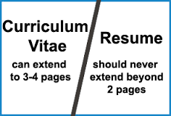
Point to Note

Slide 7
So…what’s the common aim or goal here?
RESUME/CV has a common purpose…which is to
-match your skills sets, experience and interests to the job description as much as possible

Slide 8
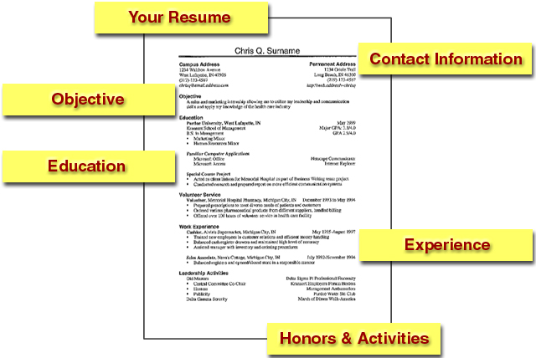
A Resume should include

Slide 9
Recommended Structure/Flow for CV
Personal Details
Education
Work/Employment Experience
Awards/Accomplishment
Key Skills/Strengths
Interests and Co-Curricullar

Slide 10
Sections of a Resume

Slide 11
The Header
What should be included?
Name
Permanent and present address
E-mail address
Telephone number
Where should contact information go?
Top of the page

Slide 12
Objective Statement
Purpose
Communicate the type of position you are interested in
Examples
Management trainee position with a specialty retailer.
Technical sales with an energy related industry in the Southwest. Long range goals of regional sales management.
To obtain a position as field service representative with XYZ Software Corporation.

Slide 13
Education
Name of Institution
Include city and state if not part of the title
Name of your degree and major
Bachelor of _________ in ___________
Bachelor of Science in Business Administration: Accounting
List degrees in reverse chronological order
Most recent degree is listed first

Slide 14
Education
Date or expected date of graduation
Graduation Date: May 2014
Expected Graduation Date: May 2015
GPA
Major or overall at least 3.0
Round down to the nearest tenth
3.0 not 3.062
GPA: 4.0, Summa Cum Laude
High School Information
Do not include after Sophomore year

Slide 15
Experience
Use the term "experience"
What is considered experience?
Full and part-time jobs
Self-employment
Volunteer work
Practicum, field, and cooperative education
Information to include
Job Title
Dates of employment
Company name
City & State

Slide 16
Listing Responsibilities
Use bullet points
Start of each line with an action verb
Present tense if currently employed
Past tense if no longer employed
Vary your choice of verbs
Tailor skills and experiences to the position for which you are applying
Be concise while providing enough detail

Slide 17
Honors & Awards
Order by dates
Reverse chronological
Rank order by importance to the career objective

Slide 18
Professional Affiliations & Activities
Order by date
Reverse chronological
Rank order by importance to the career objective
Do not say Member of …
Emphasize your leadership roles
Spell out the organization’s name:
Do not use abbreviations or acronyms

Slide 19
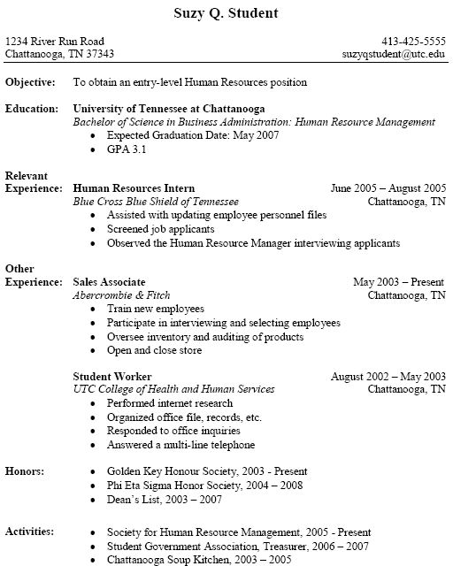

Slide 20
Activity 1: Structuring a Successful Resume
Step 1: Read through the list of information that may appear in a resume
Step 2: Decide and write down the section heading(s) that you think will best present each piece of information in a resume
Step 3: Rank each of these sections in the order that you would present them in your own resume

Slide 21
Activity
Student are required to prepare Resume & CV writing

